Slide 1
Modelling Electric Vehicle Ownership in Melbourne and Geelong
Daniel Lawson
Supervised by:
Professor Le Hai Vu
Duc Minh La
Notes:
Hello, my name is Daniel, and I will be presenting my final year project, Modelling Electric Vehicle Ownership in Melbourne and Geelong. This project was supervised by Professor Le Hai Vu and Duc Minh La.

Slide 2
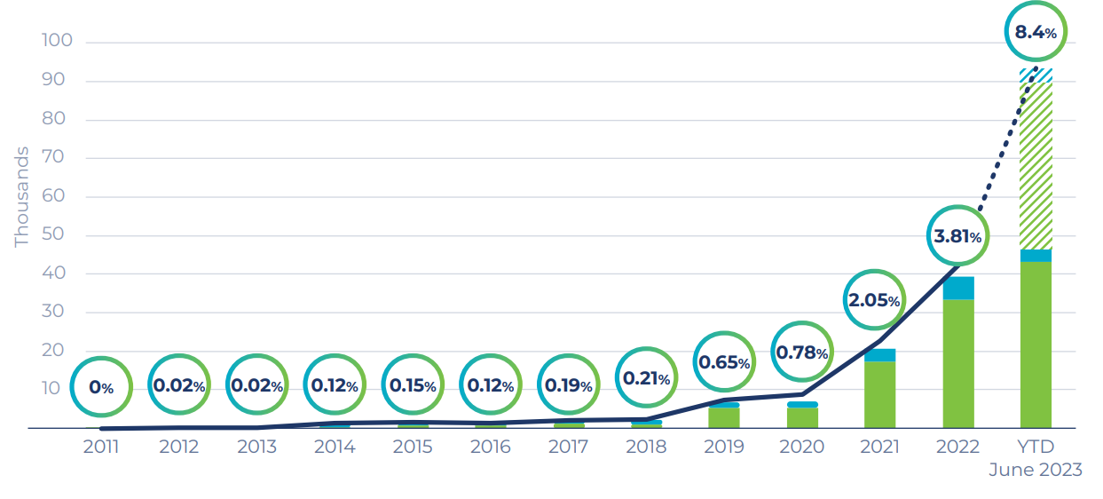
Electric Vehicle Revolution
EV Sales in Australia
Challenges
Energy Demand
Infrastructure
Inceptives
Source: State of Electric Vehicles July 2023
Notes:
Firstly, EV studies are important because our society is currently going through the EV revolution. As evident by the graph, EV sales as a proportion of total sales are growing rapidly. This shift comes with challenges such as understanding how electricity demand will change, what infrastructure will need to be built, and how incentives can be best designed to ensure a smooth transition to electrification.

Slide 3

Project Aim
Challenges
Rapid change in state
Every region is different
Aim: To capture the region-specific nuances of EVs by linking:
EV ownership
Household Attributes
Location
in one dataset
Notes:
Due to the rapid change in the state of EVs, prior studies quickly become outdated and do not transfer well between regions.
To solve this, this project aims to capture the region-specific nuances of EV ownership in Melbourne and Geelong by predicting:
which households are likely to own EVs,
their household attributes
and location.
The resulting dataset will help enable future research

Slide 4
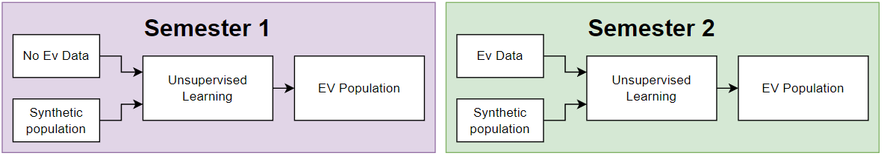
Timeline
Notes:
In this project two methods for predicting EV ownership were developed. This was done due to not having access to EV data until semester 2. The first method used unsupervised learning, whereas the second model used supervised learning.

Slide 5
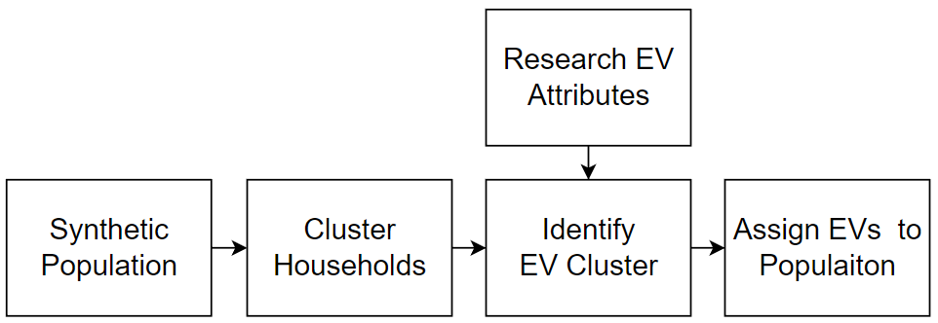
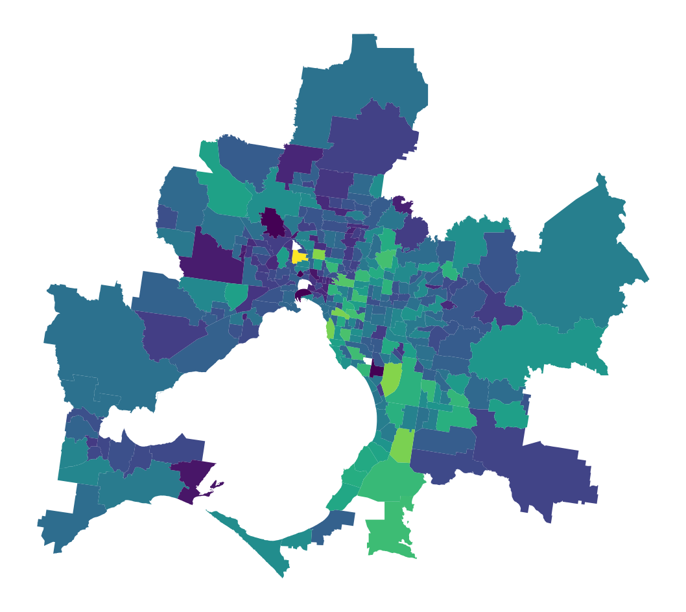

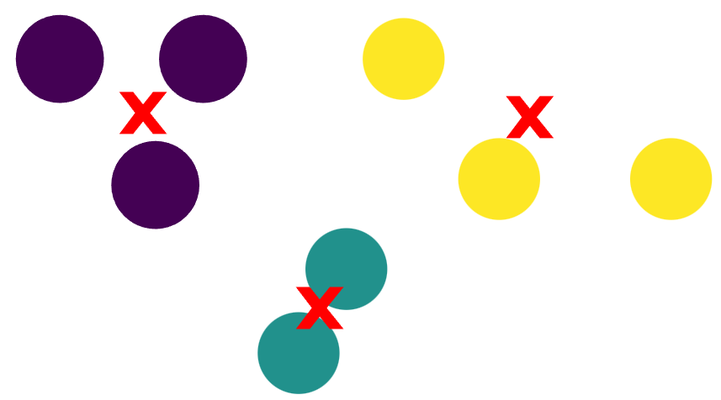
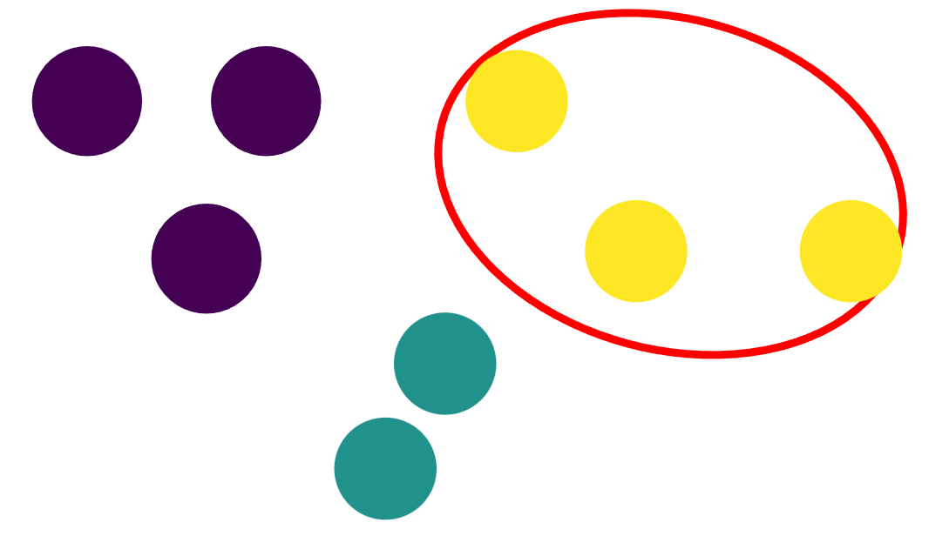
Method 1: Unsupervised Learning
Notes:
Given a synthetic population of Melbourne and Geelong and no EV data, how can the task of predicting EVs ownership be tackled?
In simple terms, households were grouped together based on how similar their household attributes were. This was done using a clustering algorithm. Then, the formed clusters were individually inspected and compared to attributes associated with EV ownership, these attributes were identified in a literature review. The best-fitting cluster had its households assigned EVs.

Slide 6
Melbourne and Geelong's EV profile
Cluster 1
Cluster 2
EV Profile
Cluster 3
Notes:
To further explain this point, I will use an example. Imagine we cluster our population into three clusters. We know that EVs exist in the population, so one of these clusters must contain EVs.
By adding the EV profile established through research to the example, we see that it does not quite match any of the clusters. However, we can update the profile to align with the most similar cluster. In this case, it is cluster 1.
And just like that, the prior EV profile has been made specific to our population’s unique demographics. Now all houses in cluster 1 are assigned an EV.

Slide 7
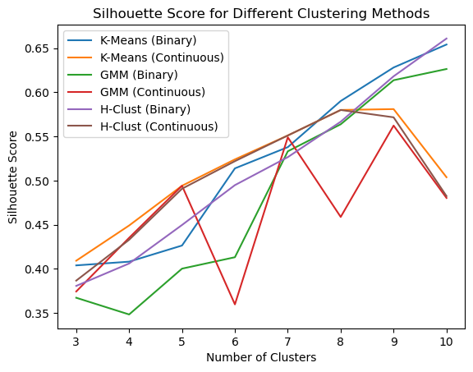
Trailing Algorithms and Feature space
Clustering Comparison
Notes:
Several clustering algorithms and feature spaces were test to find the most ideal. Two feature spaces were created: one using continuous attribute values scaled between 0 to 1, and the other using binary values. The binary feature space was created by conditionally testing individual attributes against research traits associated with EV ownership. If it aligned with the research, it was set to 1, and if it did not, it was set to 0.
This slide shows the results of this testing. The higher the silhouette score, the better the performance. In the end, K-means and the binary feature space were selected due to their consistent performance and computational efficiency.

Slide 8
Identified EV Cluster
EV Cluster Identified
 | Vehicles >= 2 | High Income | Separate House | Purchasing/Fully Own Dwelling | Age Profile | Household Size ≥ 2 | Percentage of Population
Percentage of households | 100% | 100% | 93% | 92% | 74% | 100% | 8.85%
Confirmed by Literature | ✔ | ✔ | ✔ | ✔ | ✔ | ✔
Note: 10 Clusters used
Notes:
After clustering the following attributes were in the selected EV cluster.
100% of households had 2 or more vehicles
100% were high income households.
93% had separate houses.
92% fully owned or partial owned their house
74% meet the EV age profile requirements.
100% had 2 or more members in the household.
EV cluster account for 8.85% of the total population

Slide 9
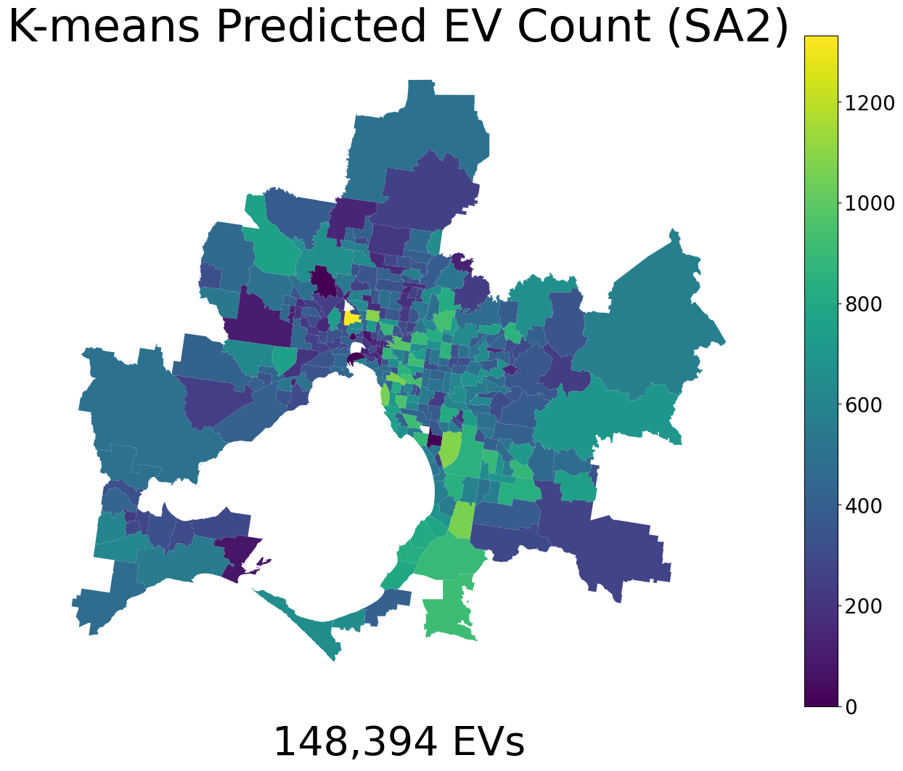
Predicted EV Ownership
Predicted: 148,394
True Number: 6,128
Over prediction: 24X
Reinterpreting the model
Prediction of household with the means to buy an EV
72% on new cars in Norway are EVs [1]
[1] State of Electric Vehicles July 2023
Notes:
The map shows the distribution of predicted EVs. The model predicted 148, 394 EVs, however once the EV data was obtained, we found the true value was 6,128. Which means an over prediction of 24times.
The over prediction highlights a key limitation of estimating EV ownership without knowing the total number of EVs. To improve this method, it needs to be able to predict a smaller amount of EVs. This could be enabled by increase the number of clusters.
The results of method 1 can be re-interpreted as a prediction of which households have the means to buy an EV in the future. If we look at it like this the prediction is no longer so unrealistic. Countries like Norway’s have seen EV sales accounting for 72% of new car sales, so it might just be a matter of time before we see adoption like that here.

Slide 10
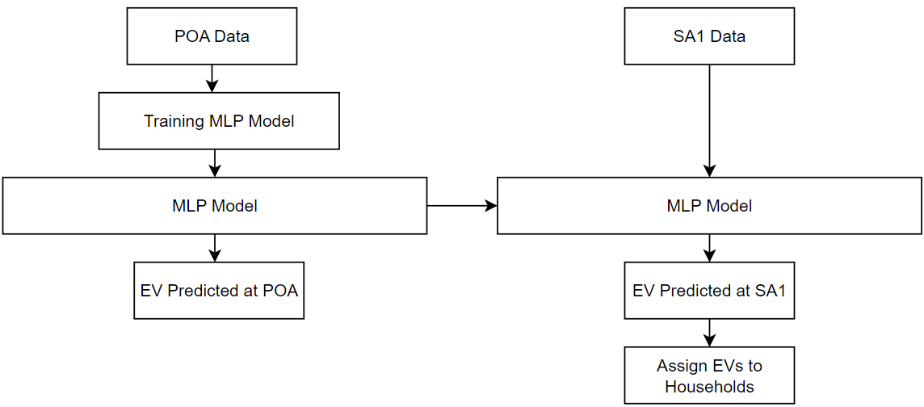
Method 2: Supervised Learning
Notes:
Now onto method two which has access to the total number of EVs in each postcode.
To make use of this additional data. Machine learning in the form of a multi-layer perception also know as an MLP was used.
Below is an brief outline of how the method works
First Data at the postcode level is used to train an MLP.
Once Train it can be used to predict the total number of EVs in another postcode.
But more importantly the model can be fed data at the SA1 level to predict at the SA1 level.
It important to note that SA1 is the smallest scale used in the project.
Now that we have predict at SA1 level the geospatial aspect of the project has been achieve. But we can go one step further an attempt to assign EVs to the most fitting households.

Slide 11
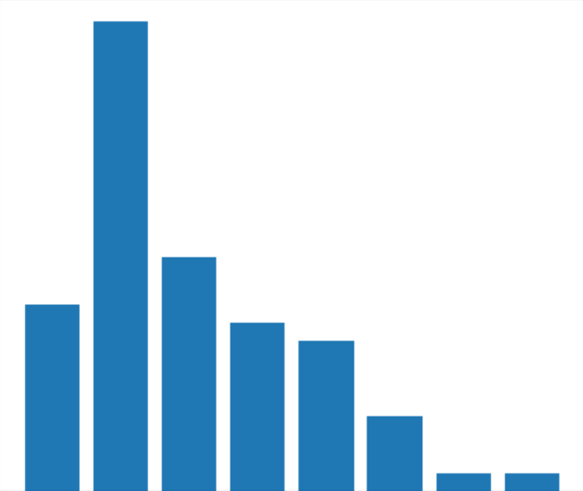
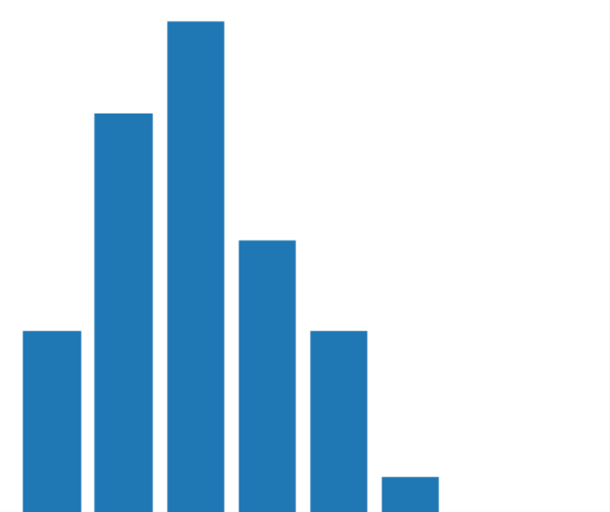
Representing a Population
Income
Number of vehicles
Area histogram fingerprint
Notes:
To create a label training set at POA and SA1. All the households’ attributes in the region would been to be aggregated to form a single feature that can be paired with the total number of EVs in that region. To achieve this a histogram of each attribute in the region were combined into a single histogram. This method helps capture the entire population rather than just the mean or median household. This can be seen below where the histogram of income and histogram of vehicles have been combined.

Slide 12
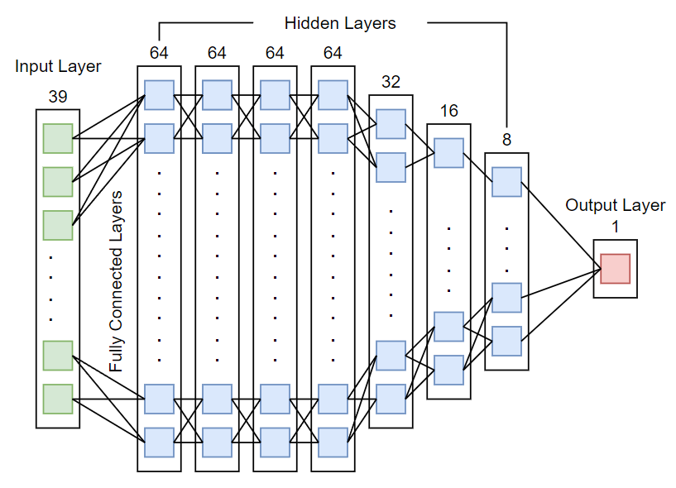
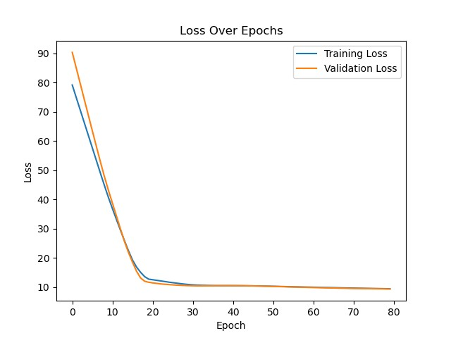
Training the MLP
Number of vehicles
Loss curve
Training Loss: ≈ 9.46 MAE
Validation Loss: ≈ 9.40 MAE
Test Loss: ≈ 7.57 MAE
Notes:
The training process involved systematically add, removing and changing the shape of the network to create a well generalised model. The Loss curve shown represents the final models training loss. You can see the model is well training as both the training and validation loss asymptote at the same loss.
The final model had a training and validation loss of approximately ≈ 9.5 MAE.
And a test loss of 7.57 MAE.

Slide 13
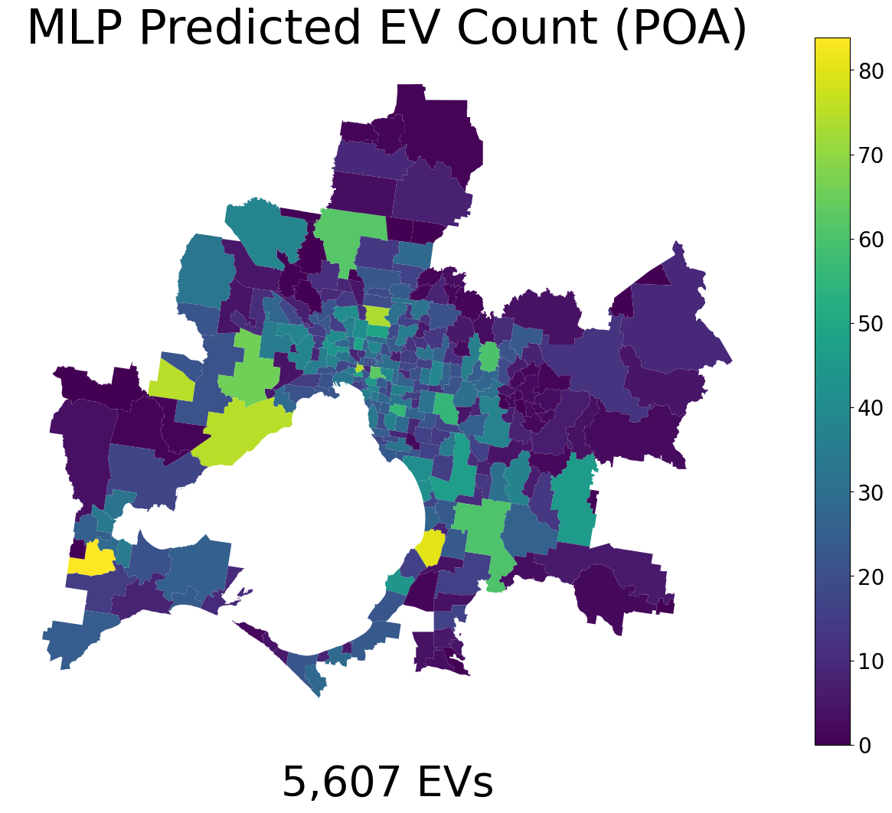
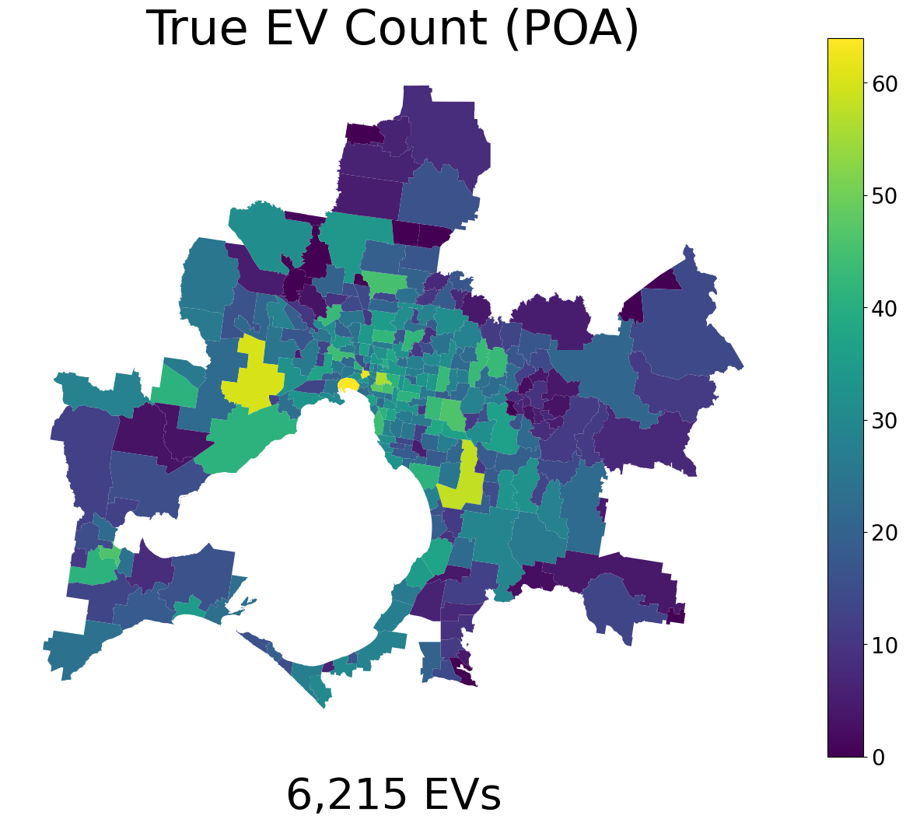
Predicted EVs (POA)
Error ≈ 10%.
Notes:
By comparing the Predicted number of EV on the left to the true number of EVs we see some strong resemblance in the distribution of EV owners.
The model predicted 5,607 EVs while the true number was 6,215 EVs, resulting in an error of approximately 10%.

Slide 14
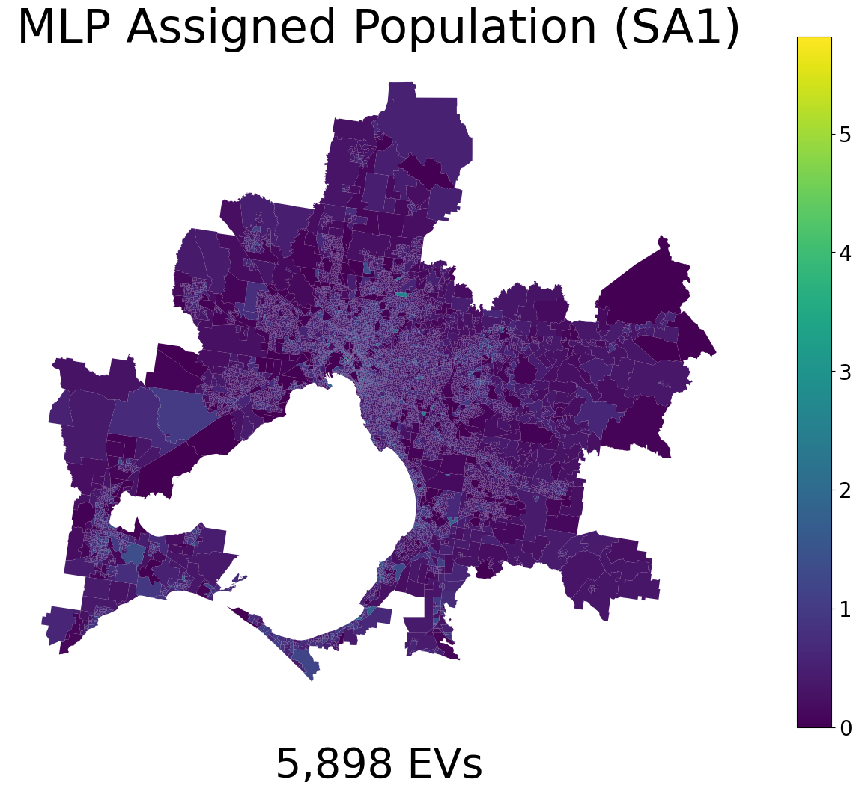
Predicted EVs (SA1)
Predicted: 5,898
True Number: 6,128
Error ≈ 5%
Notes:
Next the trained model was used to predict EVs at SA1 level. The accuracy of this model is harder to evaluate as we had no EV data at this scale. However, the model predicted a total of 5,898 EVs which resulted in an under prediction of the total EVs by only approximately 5%.
This accuracy helps to supports the notion that the model is well generalised at it predicted at Postcode level and SA1 level with similar accuracies.

Slide 15
Assigning EVs
Pearson Correlation
EV Population
Ranking | Attribute | Pearson Score | Confirmed by Literature
1 | $4,000-$4,499 | 0.198 | ✔
2 | $5,000-$5,999 | 0.177 | ✔
3 | $4,500-$4,999 | 0.175 | ✔
4 | Eight or more persons | 0.174 | ✗
5 | $6,000-$7,999 | 0.167 | ✔
6 | $3,000-$3,499 | 0.157 | ✔
 | Mean | Confirmed by Literature
Income | $1,828 | Semi
Total Vehicles | 2.6 | ✔
Household Size | 6.15 | ✔
Separate House | 81.28% | ✔
Purchasing/ Fully Owned | 66.37% | ✔
Notes:
The final step of assigning EVs was done by ranking households by how strongly their attributes were correlated with EV ownership.
The correlation of each attribute, here labelled as a Pearson Scores was provided by my supervisor Bob. Households in each Sa1 were rank by the summation their attributes correlation. Then the EVs in each SA1 was assigned to the highest-ranking households.
The final EV population had the following attributes.
Average income of $1,828
2.6 vehicles
6.15 people in the household
81.28% were separate homes
And 66% were being purchased or are already fully owned.
All attributes were support in full or partially by prior research.

Slide 16
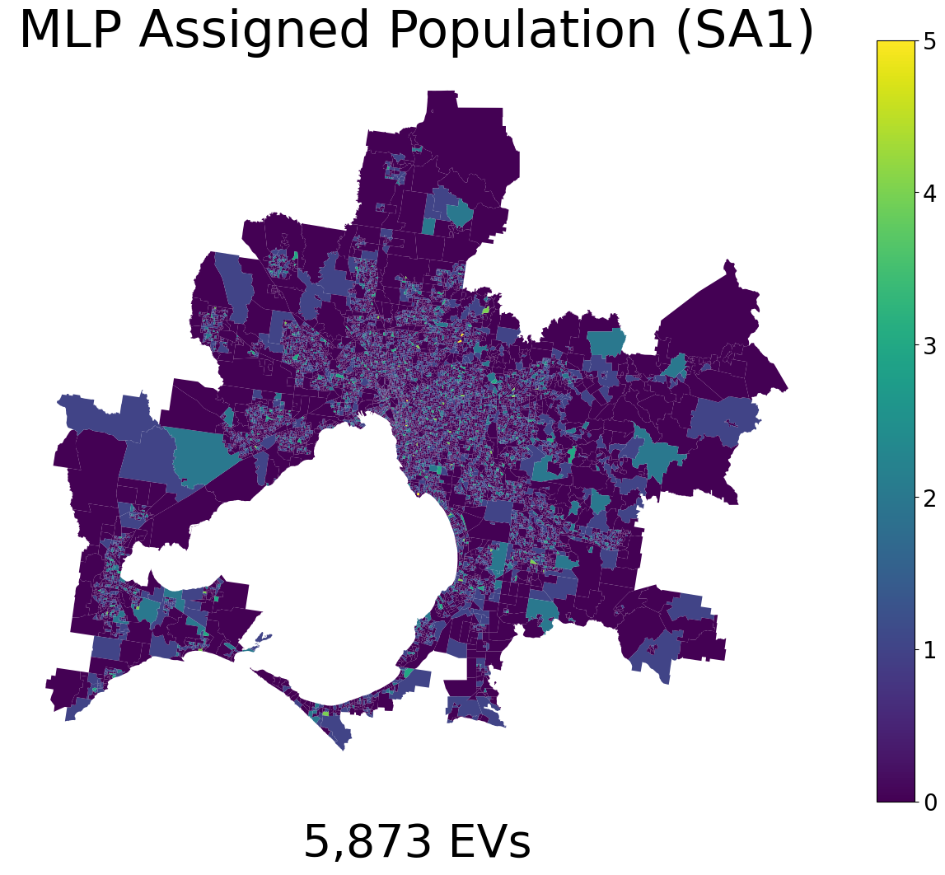
Final Assigned Population
Notes:
The final population is shown below. You may notice it looks slightly different to the previous map, this is because the number of EVs was rounded to allow them to be assigned to individual households.

Slide 17
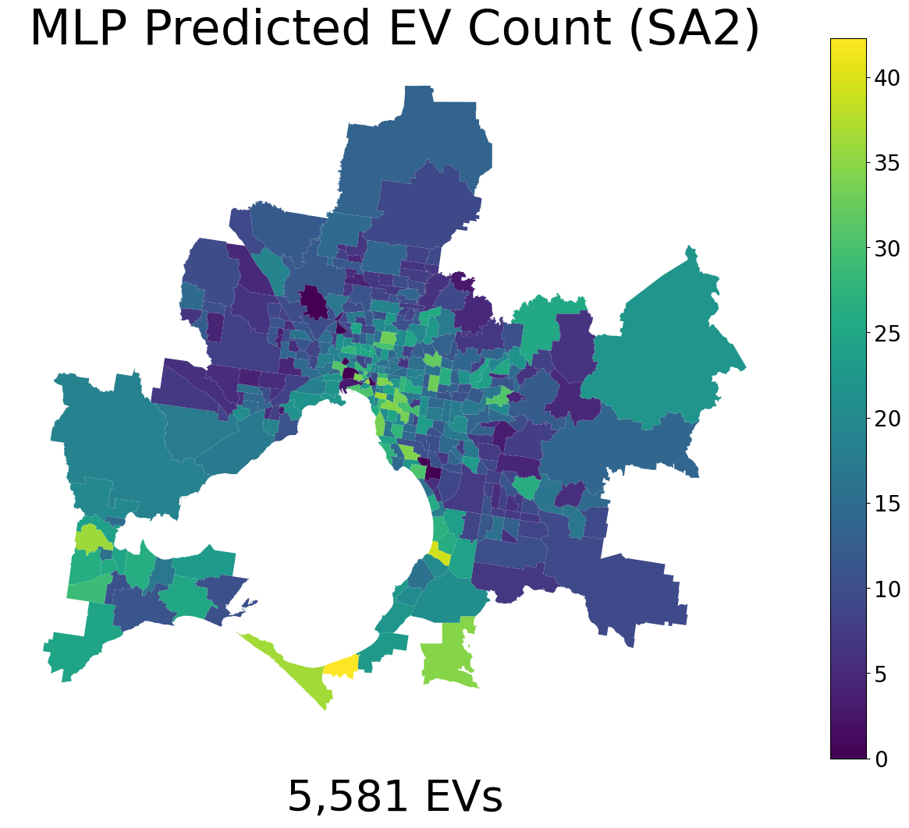
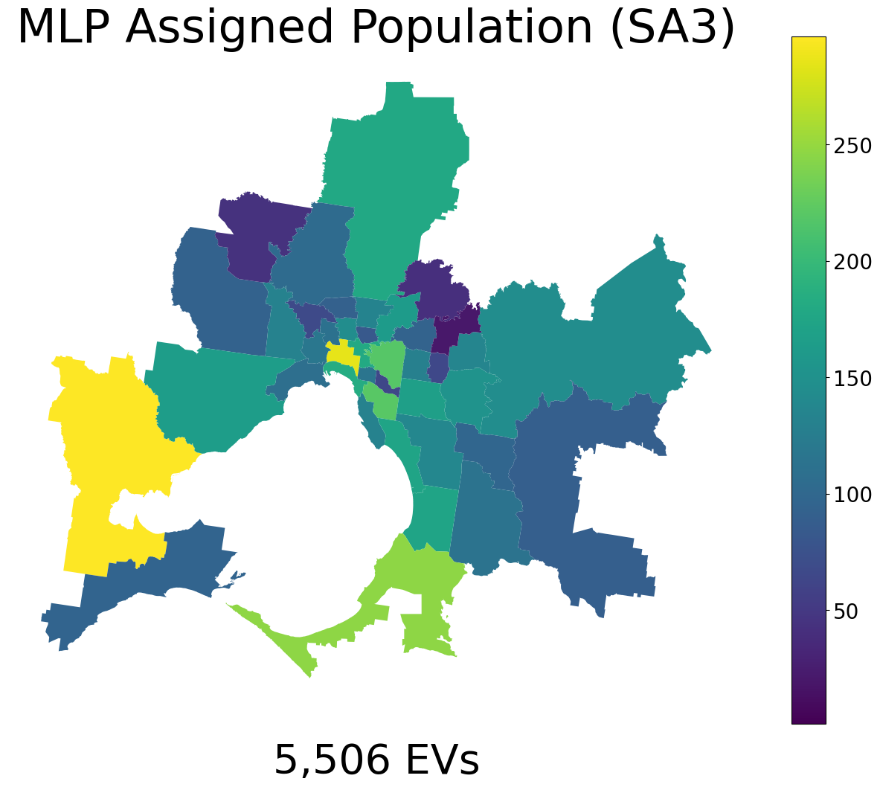
Summary
Aim: capturing the nuances of EVs in Melbourne/ Geelong
By: understanding
 | EV ownership | Household attributes | Household location | Accurate
Method 1 | ✔ | ✔ | ✔ | ✗
Method 2 | ✔ | ✔ | ✔ | ✔
 | Informed by
Infrastructure | Household location
EV Inceptives | Household attributes
Energy Demand | Location & Attributes
Notes:
Now to summarise the project. The project had the initial aim of
Capturing the nuances of EVs in Melbourne/ Geelong
by producing a dataset containing.
Which households own EVs
Their household attributes.
and Location
Method 1. Produced a framework could achieve this but is need further need of development to improve its accuracy.
Method 2: Achieved all aspects of the aim and furthermore, the model can be used to predict the number of EVs at various geospatial levels such as Postcode, SA1, SA2 and SA3.
The dataset produced by this project can be used in the future to guide new infrastructure, model energy demand and guide EV adoption incentives.
I would like to conclude by thanking both my supervisor for providing me with guidance and encouragement throughout the project.

